Slide 1
MCQs on Tree

Slide 2
Q)Suppose the numbers 7, 5, 1, 8, 3, 6, 0, 9, 4, 2 are inserted in that order into an initially empty binary search tree. The binary search tree uses the usual ordering on natural numbers. What is the in-order traversal sequence of the resultant tree?
(A) 7 5 1 0 3 2 4 6 8 9 (B) 0 2 4 3 1 6 5 9 8 7 (C) 0 1 2 3 4 5 6 7 8 9 (D) 9 8 6 4 2 3 0 1 5 7

Slide 3
Q)Suppose the numbers 7, 5, 1, 8, 3, 6, 0, 9, 4, 2 are inserted in that order into an initially empty binary search tree. The binary search tree uses the usual ordering on natural numbers. What is the in-order traversal sequence of the resultant tree?
(A) 7 5 1 0 3 2 4 6 8 9 (B) 0 2 4 3 1 6 5 9 8 7 (C) 0 1 2 3 4 5 6 7 8 9 (D) 9 8 6 4 2 3 0 1 5 7 Answer: (C) Explanation: In-order traversal of a BST gives elements in increasing order. So answer c is correct without any doubt.

Slide 4
Q)The preorder traversal sequence of a binary search tree is 30, 20, 10, 15, 25, 23, 39, 35, 42. Which one of the following is the postorder traversal sequence of the same tree? (A) 10, 20, 15, 23, 25, 35, 42, 39, 30 (B) 15, 10, 25, 23, 20, 42, 35, 39, 30 (C) 15, 20, 10, 23, 25, 42, 35, 39, 30 (D) 15, 10, 23, 25, 20, 35, 42, 39, 30

Slide 5
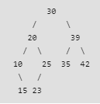
Q)The preorder traversal sequence of a binary search tree is 30, 20, 10, 15, 25, 23, 39, 35, 42. Which one of the following is the postorder traversal sequence of the same tree? (A) 10, 20, 15, 23, 25, 35, 42, 39, 30 (B) 15, 10, 25, 23, 20, 42, 35, 39, 30 (C) 15, 20, 10, 23, 25, 42, 35, 39, 30 (D) 15, 10, 23, 25, 20, 35, 42, 39, 30 Answer: (D) Explanation:
Sort the preorder to get the Inorder Traversal, then construct the tree
The following is the constructed tree

Slide 6
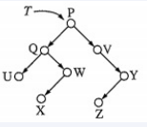
ISRO | ISRO CS 2014 | Question 41
Consider the following binary search tree T given below: Which node contains the fourth smallest element in T?
(A) Q (B) V (C) W (D) X

Slide 7
ISRO | ISRO CS 2014 | Question 41
Consider the following binary search tree T given below: Which node contains the fourth smallest element in T?
(A) Q (B) V (C) W (D) X Answer: (C)
Inorder Traversal=UQXWPVZY
Is in sorted order , so ans=W

Slide 8
ISRO | ISRO CS 2009 | Question 26
The following numbers are inserted into an empty binary search tree in the given order: 10, 1, 3, 5, 15, 12, 16. What is the height of the binary search tree (the height is the maximum distance of a leaf node from the root)? (A) 2 (B) 3 (C) 4 (D) 6

Slide 9
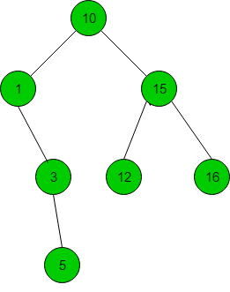
ISRO | ISRO CS 2009 | Question 26
The following numbers are inserted into an empty binary search tree in the given order: 10, 1, 3, 5, 15, 12, 16. What is the height of the binary search tree (the height is the maximum distance of a leaf node from the root)? (A) 2 (B) 3 (C) 4 (D) 6
Answer: (B) Explanation:
So, height of the tree is 3, option (B) is correct.

